Slide 1
Silver to Grid Data Services
Session I: Overview of Training and a Demo of caGrid Semantic
Interoperability
caBIG™ Annual Meeting
June 23-25, 2008
Notes:
Welcome to Session 1 of the silver to grid data services. My name is peter mcgarvey and I will give the first half of this presentation

Slide 2
Overview of Sessions I - III
Divided into three 1 hour 15 minutes sessions
Tuesday | Wednesday
10:15 - 11:30 a.m. | 10:00 - 11:15 a.m. | Session I: Overview of the Silver to Grid training program. Presentation and Live Demo of caGrid Semantic Interoperability.
12:45 - 2:00 p.m. | 12:30 - 1:45 p.m | Session II (Lessons 1-5): Developing a Silver-Level Compatible Data Service API
2:15 - 3:30 p.m. | 2:00 - 3:15 p.m | Session III (Lessons 6-9): Deploying a Data Service on caGrid and using caGrid Service APIs
Notes:
This is an overview of the overview slide on what is covered in the 3 sessions today and repeated tomorrow.
Session 1:
Overview of the Silver to Grid training program. (2 Parts:Includes contents of the full hands-on training program and the short versions we present today)
Presentation and Live Demo of caGrid Semantic Interoperability. (What you will be able to do on the grid if you complete the full training. You should have the knowledge, tools and code to do the demo yourself.)
Sessions 2-3 are a short course training with key highlights from the full course, not full details or examples, no hands on exercises or demos. This might be enough for some to get started.
Session 2:
Developing a Silver-Level Compatible Data Service API
Session 3: Deploying a Data Service on caGrid and using caGrid Service APIs

Slide 3
Acknowledgements
Peter McGarvey
Baris Suzek
Mike Keller
Dianne Reeves
George Komatsoulis
Avinash Shanbhag
Becky Angeles
Jennifer Brush
Jamie Parker
Claire Wolfe
Ken Smith
Sal Mungal
Virginia Hetrick
Shannon Hastings
Architecture/VCDE workspace participants

Slide 4
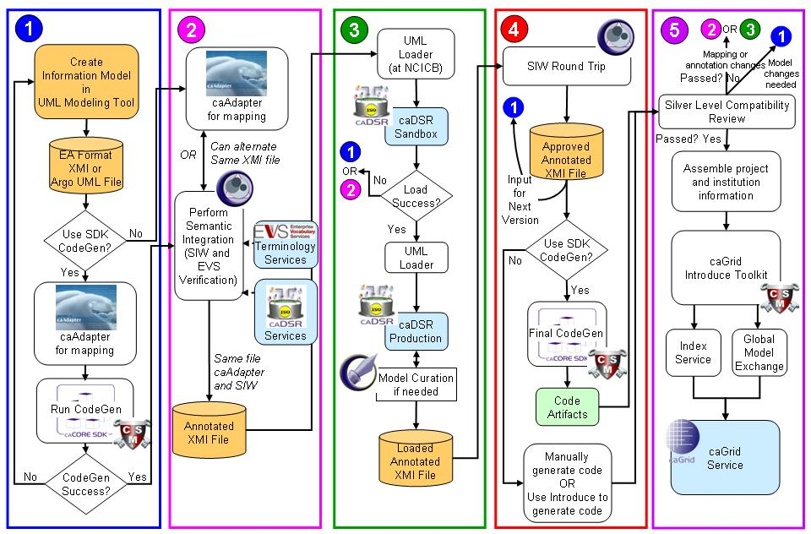
Why Training?
caCORE SDK centric caGrid data service development
Notes:
Why a training program? This slide should help make that apparent☺
This is a diagram of the complete process as it stands today using the caCORE SDK; a toolkit developed at NCI Center for Bioinformatics to help in development of caBIG compliant services.
You will see this diagram many times throughout the sessions/lessons today
Though folks got through this process without this diagram or training as you might imagine it was painful and confusing for some. The training is to help ease your pain and help folks through the process and prepare them with knowledge of why the steps exist and how to get through them.

Slide 5
Session I-III : Introduction
Intended to cover most all steps to develop a data service from an idea to a caGrid data service
Uses Grid-enablement of Protein Information Resource (gridPIR)
as applicable
Shows “one” path to develop a data service; not necessarily all possible ways of doing so
A short version of “Silver to Grid Training Module” available at caBIG™ gForge site:
http://gforge.nci.nih.gov/docman/index.php?group_id=470&selected_doc_group_id=3075&language_id=1
Notes:
Path with least pain.

Slide 6
Sessions I - III : Background
Goal:
Prepare a participant to create and deploy a caBIG™ silver level compatible grid-enabled data service
Learning Objective:
After attending today's session a participant will have an understanding of steps needed to develop a caBIG™ silver level compatible grid-enabled data service
Notes:
Our intention today is not to delve into great details but demonstrate that it is not so hard to develop such a service with right tooling and understanding.
Goal:
Prepare a participant to create and deploy a caBIG™ silver level compatible grid-enabled data service
Learning Objective:
After attending today's session a participant will have an understanding of steps needed to develop a caBIG™ silver level compatible grid-enabled data service

Slide 7
Session I-III: Background – cont’d
Audience
  Interested in creating caBIG™ compatible applications
  Familiar with Java development
  Familiar with UML
  Familiar with semantic interoperability
  Familiar use case-driven development
Notes:
This is the recommended background for folks attending the short-course sessions here at the annual meeting. If you are missing some you may still come away with useful knowledge.
If you took the full-hands on course or boot camp we up the background requirements some and assume you are a developer and have more experience with Java and UML.

Slide 8
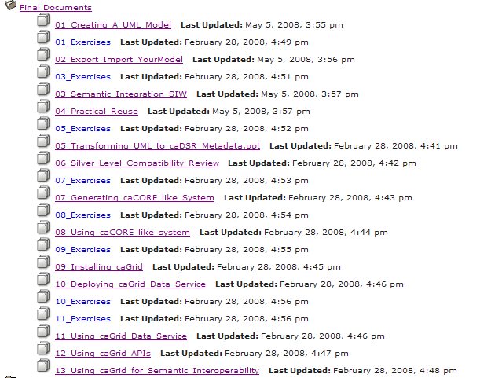
Introduction – Full Training Module
http://gforge.nci.nih.gov/docman/index.php?group_id=470&selected_doc_group_id=3075&language_id=1
Slides and exercises for different lessons
Notes:
This is the complete 13 lesson training materials for the full details hands-on training module, It will be available for self training via the web and articulate and offered as part of a full day boot-camp style training in the future. There are slide decks and exercises.

Slide 9
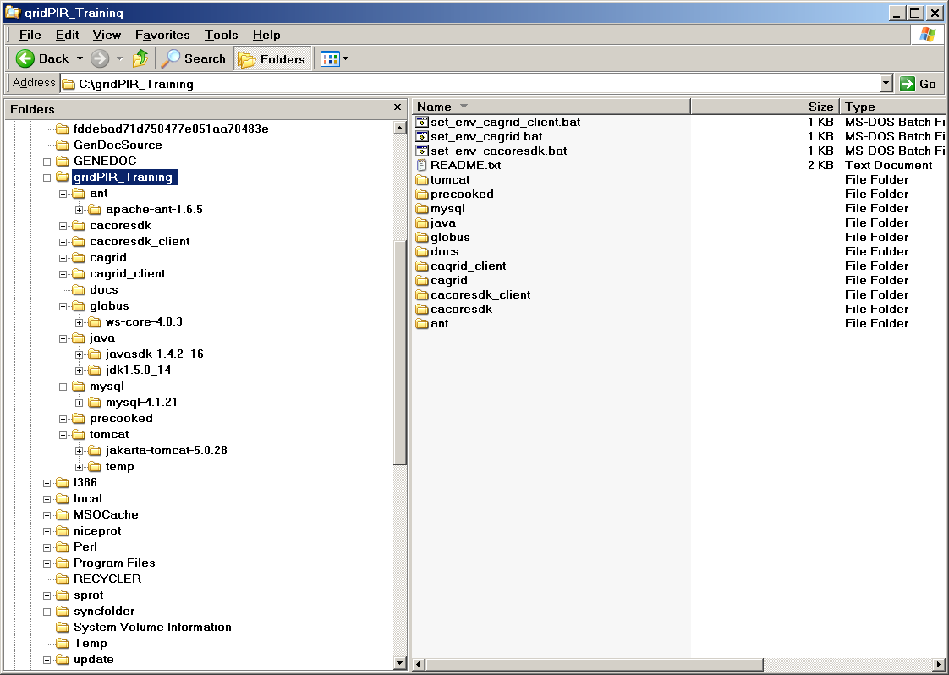
Introduction – Full Training Module
A self-contained codebase that includes all the libraries and software for a Windows environment:
http://gforge.nci.nih.gov/frs/download.php/4195/gridPIR_Training.zip
Tomcat Jakarta Ant v1.6.5 for building caCORE SDK/caGrid
caCORE SDK 3.2.1 configured to deploy gridPIR
caCORE SDK 3.2.1 client code to query gridPIR
Local caGrid 1.2 installation and gridPIRService
caGrid 1.2 service clients ; Data, Discovery, EVS and caDSR
Useful docs for caGrid and caCORE SDK
Globus Toolkit needed for caGrid 1.2
Different Java SDK versions for caCORE SDK and caGrid
Local MySQL to host sample data for local gridPIR service
Precooked deployment/client use steps
Tomcat 5.0.28 container for caGrid/gridPIR API and data service
Notes:
The full training offers a self-contained codebase that includes all the libraries and software for a Windows environment:
The demo you will see this session uses this code base.
If you hear us refer to the full training for more details in these sessions this is what we mean.

Slide 10
Overview of Today’s Lessons
caCORE SDK centric caGrid data service development
Notes:
Here it is again as promised
We will cover all of this at some level (not all details or options) in the 3 sessions today

Slide 11
Session II
Notes:
Session 2 today after lunch covers key steps this part of the process
Information Modeling
Semantic Annotation
Loading Model to caDSR
Generating the API
Using a caCORE-like System

Slide 12
Session II: Lessons
Lesson 1: Modeling Your Domain in UML
Lesson 2: Semantically Annotating Your UML Model
Lesson 3: Transforming Model to caDSR Metadata
Lesson 4: Generating a caCORE-like System
Lesson 5: Using a caCORE-like System
Notes:
Session II today after lunch covers key steps this part of the process
Lesson 1: Modeling Your Domain in UML
Lesson 2: Semantically Annotating Your UML Model
Lesson 3: Transforming Model to caDSR Metadata
Lesson 4: Generating a caCORE-like System
Lesson 5: Using a caCORE-like System

Slide 13
Lesson 1:
Modeling Your Domain in UML
Description of the first and one of the most important steps for caBIG™ which uses a Model Driven Approach
Focus: How to develop a domain information model in caBIG™?
  A Domain Information Model is a representation of our understanding of an area of knowledge
  A Domain Information Model consist of ‘Classes’ that represent ‘things’ in the real world
  Classes contain attributes that are characteristics of different instances of things in the real world
Includes examples from gridPIR model and modeling practices
Notes:
Description of the first and one of the most important steps for caBIG which uses a Model Driven Approach
Not any modeling but modeling for caBIG. Basically developing a “domain
Information model” which can be different and some constraints in current tooling that might affect your model.
Focus: How to develop a domain information model in caBIG?
A Domain Information Model is a representation of our understanding of an area of knowledge
A Domain Information Model consist of ‘Classes’ that represent ‘things’ in the real world
Classes contain attributes that are characteristics of different instances of things in the real world
Includes examples from gridPIR model and modeling practices

Slide 14
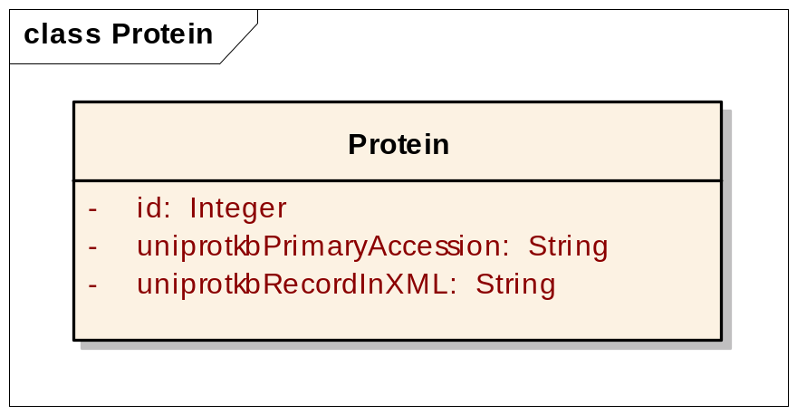
Lesson 1:
Modeling Your Domain in UML
Is this a good model for caBIG™? No
But why?
P99999
<uniprot xmlns="http://uniprot.org/uniprot" xmlns:xsi="http://www.w3.org/2001/XMLSchema-instance" xsi:schemaLocation="http://uniprot.org/uniprot http://www.uniprot.org/support/docs/uniprot.xsd"> <entry dataset="Swiss-Prot" created="1986-07-21" modified="2007-01-23" version="44"> <accession>P99999</accession> <accession>P00001</accession> <accession>Q6NUR2</accession> <accession>Q6NX69</accession> <accession>Q96BV4</accession> <name>CYC_HUMAN</name> <protein> <name>Cytochrome c</name> </protein> <gene> <name type="primary">CYCS</name> <name type="synonym">CYC</name> </gene> <organism key="1"> <name type="scientific">Homo sapiens</name> <name type="common">Human</name> <dbReference type="NCBI Taxonomy" id="9606" key="2"/> <lineage> <taxon>Eukaryota</taxon> <taxon>Metazoa</taxon> <taxon>Chordata</taxon> <taxon>Craniata</taxon> <taxon>Vertebrata</taxon> <taxon>Euteleostomi</taxon> <taxon>Mammalia</taxon> <taxon>Eutheria</taxon> <taxon>Euarchontoglires</taxon> <taxon>Primates</taxon> <taxon>Haplorrhini</taxon> <taxon>Catarrhini</taxon> <taxon>Hominidae</taxon> <taxon>Homo</taxon> </lineage> </organism>
……
Notes:
In the lesson we have examples of bad, better, and best models and discuss why.
This is an extreme example of a bad model.
Although valid, do not expose all the information or real world “things”; Organism/Gene/Taxon/Lineage/Active Sites etc.

Slide 15
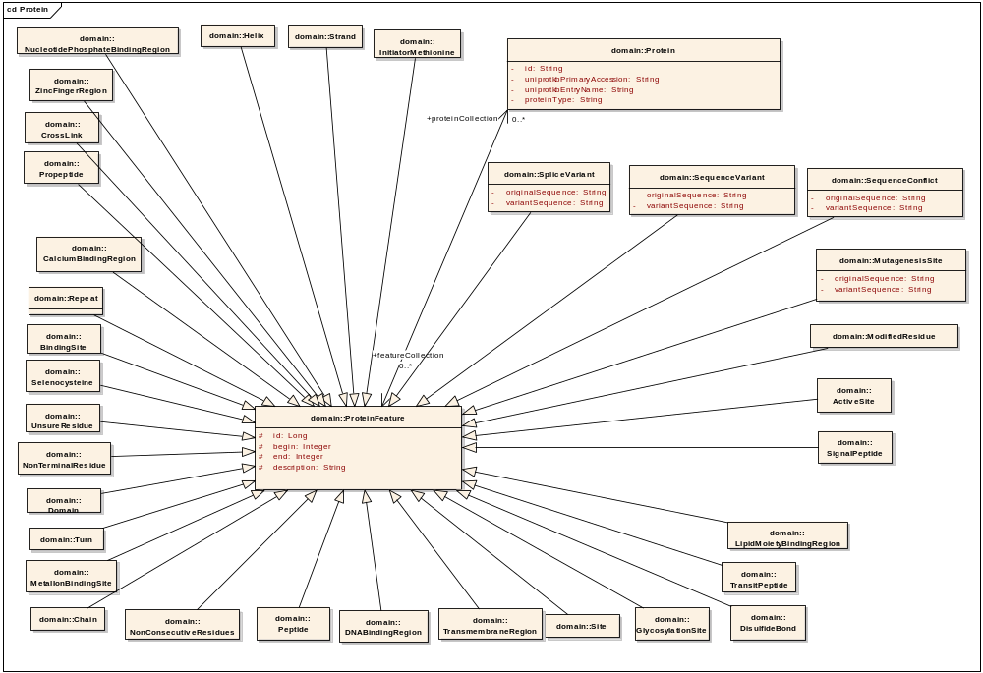
Lesson 1:
Modeling Your Domain in UML
Why do we have such models?
Notes:
A picture of all sequence based features of a protein. Our best model example. It is extreme is some other ways but we cover why this is good model for our use cases and caBIG.
E.g. you can immediately say we are exposing “SignalPeptide” or “ActiveSite” information. As something you can discover before an query.
Note that the model itself is pretty informative; if you are familiar with the domain, you don’t need to contact developers to ask for contents of the service.
caBIG has best practices and some technical requirements related to modelling that you will learn.

Slide 16
Lesson 2:
Semantically Annotating Your UML Model
Description of the tools and process of annotating your UML model
Focus: How to semantically annotate/enrich your model using?
  Semantic Integration Workbench (SIW) tool
  Concepts from Enterprise Vocabulary Services (EVS)
  Reusing Common Data Elements (CDE) from Cancer Data Standards Repository
Includes some examples from gridPIR
Notes:
Semantic annotation is an important task for caBIG many have never been exposed to before.
Human language is confusing to computers and many humans we sometimes use the same words for slightly different concepts, and in medicine and science have lots of specific jargon that means different things to people in different fields. This step is critical to help clear this up.
Description of the tools and process of annotating your UML model
Focus: How to semantically annotate/enrich your model using?
Semantic Integration Workbench (SIW) tool
Concepts from Enterprise Vocabulary Services (EVS)
Common Data Elements (CDE) from Cancer Data Standards Repository (caDSR) – Reusing CDEs
Includes some examples from gridPIR

Slide 17
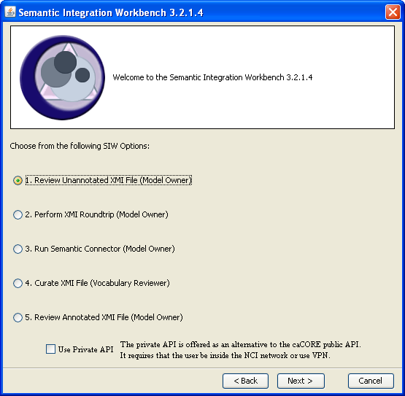
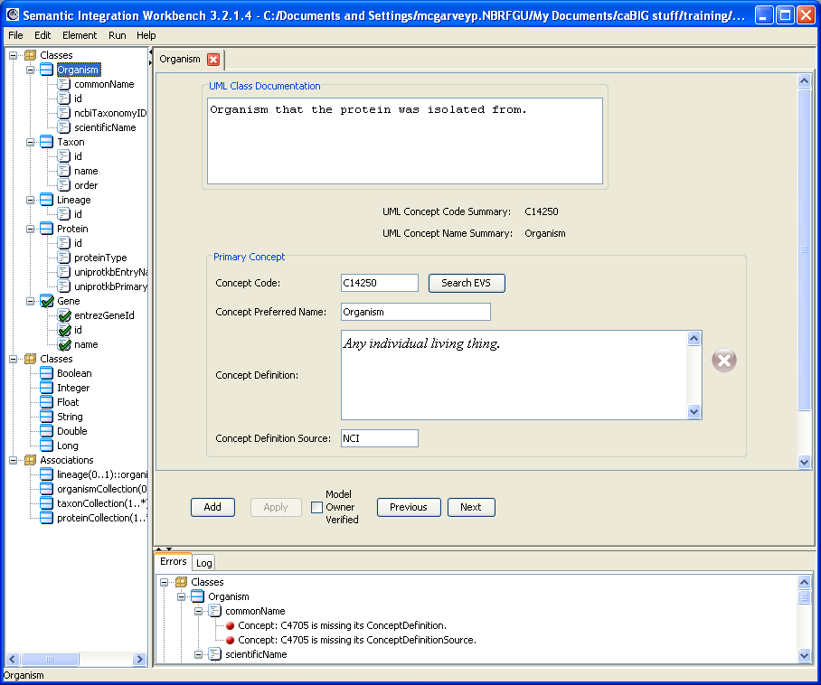
Lesson 2:
Semantically Annotating Your UML Model
Notes:
This is the list of options in the SIW.
Semantic Integration Workbench has multiple options that helps you to annotate the model. Its input is an XMI file generated by a UML modeling tool.
Here EVS concept for “Organism” is used to annotate a class.
SIW can try to identify “best” concepts using “class/attribute” names. However a curation is needed.
Annotation by the developer and domain specialists and EVS team is required here.

Slide 18
Lesson 3:
Transforming Model to caDSR Metadata
Description of the procedure to submit and load you model to Cancer Data Standards Repository (caDSR)
Focus: What is needed for the load?
  Contents of the submission package
  Steps involved
  Outcome
Notes:
Annotated XMIs which are your uml model and sematic annotation are loaded into caDSR.
The load process is handled by NCICB, not by developers.
There is SOP for it.

Slide 19
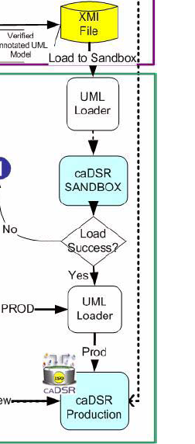


Lesson 3:
Transforming Model to caDSR Metadata
Submission
package
Verify concepts
Add concepts
Check errors
NCICB Help Desk
Notify user
caDSR Sandbox
NCICB Help Desk
Verify concepts
check errors
Revised
Submission
package
NCICB Help Desk
Notes:
Developer submits a package that includes the annotated XMI.
Developer usually interacts with NCICB helpdesk.
NCICB helpdesk forwards it to EVS curators for verification and checking of concepts and then UML load team.

Slide 20
Lesson 4:
Generating a caCORE-like System
Description of the configuration and process to generate a caCORE-like system; a silver level compatible API
Covers: Configuration of caCORE SDK, object-to-relational mapping (ORM), building and testing the system
Notes:
Description of the configuration and process to generate a caCORE-like system; a silver level compatible API
Covers: Configuration of caCORE SDK, object-to-relational mapping (ORM), building and testing the system
First code generation is for test purposes. To check whether an API can be generated from the model and whether it meets use cases. Further work is done only under these circumstances.
The input to process is an XMI.

Slide 21
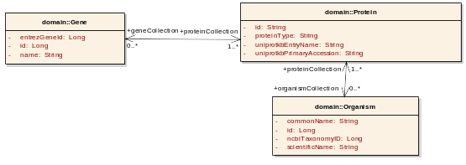
Lesson 5:
Using a caCORE-like System
Description of Query by Example (QBE) and ApplicationService Interface
Find Protein objects for Human Breast cancer 1 (BRCA1)
// initialize protein object
Protein protein=new Protein();
protein.setGeneCollection(geneCollection);
protein.setOrganismCollection(organismCollection);
//invoke query
List resultList = appService.search(Protein.class, protein);
//process results
for (Iterator resultsIterator = resultList.iterator(); resultsIterator.hasNext();) {
Protein returnedProtein = (Protein) resultsIterator.next();
//print results
Notes:
This is how to use the APIs the SDK generates

Slide 22
Summary of Session II
Notes:
And that is what you will get in more detail in session II after lunch.
Information Modeling
Semantic Annotation
Loading Model to caDSR
Generating the API
Using a caCORE-like System

Slide 23
Session III
Notes:
Session III we cover
caGrid Node Installation (prerequsite)
Data Service Deployment on caGrid
Using caGrid data service API
Using caGrid Metadata APIs

Slide 24
Session III: Lessons
Lesson 6: Installing caGrid node for Data Service Deployment
Lesson 7: Deploying a caGrid Data Service
Lesson 8: Using caGrid Data Services
Lesson 9: Using caGrid Metadata Service APIs
Notes:
Session III today after lunch covers key steps this part of the process
Lesson 6: Installing caGrid node for Data Service Deployment
Lesson 7: Deploying a caGrid Data Service
Lesson 8: Using caGrid Data Services
Lesson 9: Generating a caCORE-like System
Lesson 10: Using caGrid Metadata Service APIs

Slide 25
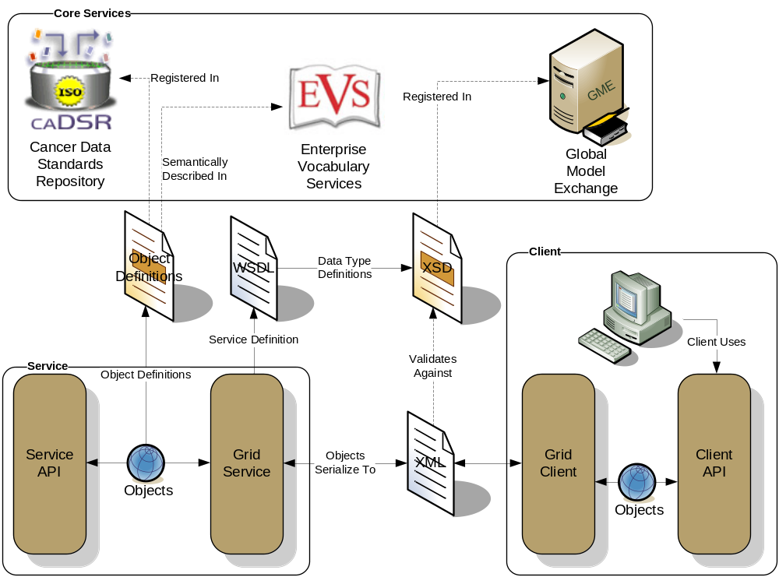
Lesson 6:
Installing caGrid node for Data Service Deployment
Description of step-by-step installation of caGrid node
Notes:
caGrid infrastructure is in fact pretty complex, includes clients to interact with caGrid core services, Introduce Toolkit to deploy services, Globus toolkit, necessary libraries, containers and more.
User do not need to deal with this complex structure. caGrid Installer you will see in this section makes installation easy.

Slide 26

Lesson 7:
Deploying a caGrid Data Service
Focus: How to use the caCORE SDK generated artifacts and the Introduce Toolkit to create a caGrid Data Service.
Notes:
Introduce hides low level details of service deployment.
Interacts with necessary caGrid core services such as Index Service, Global Model Exchange, caDSR

Slide 27
Lesson 8:
Using caGrid Data Services
Focus: How to create and run queries in caBIG™ Query Language (CQL)?
Covers:
  Using caGrid Portal to query data services
  Using Generic Data Service Client to query data services
  Creating and running queries in caBIG™ Query Language (CQL)
Notes:
Focus: How to create and run queries in caBIG Query Language (CQL)?
Covers:
Using caGrid Portal to query data services
Using Generic Data Service Client data services
Creating and running queries in caBIG Query Language (CQL)

Slide 28
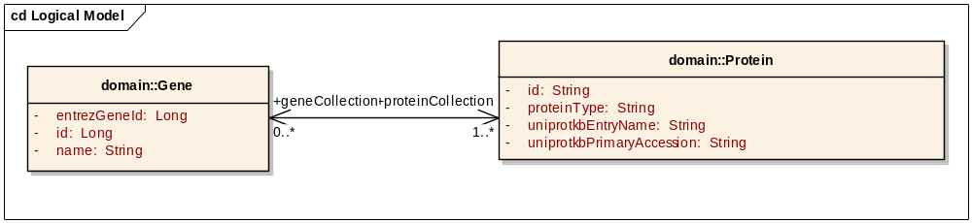
Lesson 8:
Using caGrid Data Services
A query in caBIG Query Language(CQL) to retrieve Protein objects for “BRCA1” Gene.
<?xml version="1.0" encoding="UTF-8"?>
<ns1:CQLQuery xmlns:ns1="http://CQL.caBIG/1/gov.nih.nci.cagrid.CQLQuery">
<ns1:Target name="edu.georgetown.pir.domain.Protein">
<ns1:Association name="edu.georgetown.pir.domain.Gene" roleName="geneCollection">
<ns1:Attribute name="name" predicate="EQUAL_TO" value="brca1"/>
</ns1:Association>
</ns1:Target>
</ns1:CQLQuery>
Notes:
A CQL query to get Protein objects for “BRCA1” Gene

Slide 29
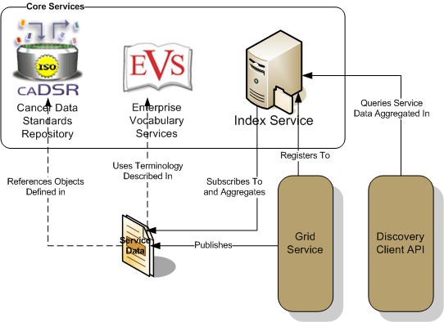
Lesson 9:
Using caGrid Metadata Service APIs
Focus: How to use production caGrid metadata service APIs?
Covers:
  caDSR/EVS/Discovery APIs
  Metadata Utilities
Notes:
Use Discovery Client API to discover services
EVS to query vocabularies/concepts
caDSR to extract registered metadata including models/data elements

Slide 30
Conclusion Session III
Notes:
That’s it in session III we will cover
caGrid Node Installation (prerequsite)
Data Service Deployment on caGrid
Using caGrid data service API
Using caGrid Metadata APIs
We hope the lessons will provide you a better understanding of overall steps needed to create caGrid Silver-Level Compatible system.

Slide 31
Additional Resources
caBIG™ web site: https://cabig.nci.nih.gov/
caBIG™ gForge site: https://gforge.nci.nih.gov/
caGrid Wiki: http://www.cagrid.org/
caBIG™ Learning Management System:
http://ncicbtraining.nci.nih.gov/TP2005/tp2000web.dll/NCICBTraining
caCORE SDK: http://ncicb.nci.nih.gov/infrastructure/cacoresdk
caBIG™ Compatibility Guidelines:
https://gforge.nci.nih.gov/docman/index.php?group_id=233&selected_doc_group_id=1138&language_id=1
Upcoming boot camps

Slide 32
Questions so far?

Slide 33
Session I so far: Overview of Training
Notes:
Session 2 today after lunch covers key steps this part of the process
Information Modeling
Semantic Annotation
Loading Model to caDSR
Generating the API
Silver Level Compatibility Process

Slide 34
Session I Next:
caBIG™ Silver Level Compatibility: What we want for Silver Level Compatibility?
Using caGrid for Semantic Interoperability (Demo): Why we want all these for Silver Level Compatibility?
Notes:
Session 2 today after lunch covers key steps this part of the process
Information Modeling
Semantic Annotation
Loading Model to caDSR
Generating the API
Silver Level Compatibility Process

Slide 35
caBIG™ Silver Level Compatibility

Slide 36
Silver Level Compatibility
Notes:
Silver level compatibility review is to the end of process.
However it important to learn the requirements of compatibility and why they are needed before the development.
So I will try to summarize them now.

Slide 37
Interoperability
The ability of a system to access and use
the parts of another system
Syntactic
Interoperability
Semantic
Interoperability
Notes:
Compatibility is about interoperability.
In other words, if we develop a system that achieves caBIG Silver or Gold level compatibility, then that system likely to be interoperable with others.
Our focus is, of course, computable interoperability (without human intervension):
There are two types of interoperability:
Syntactic interoperability – the ability to exchange information
Semantic interoperability – the ability to use the information that has been exchanged

Slide 38
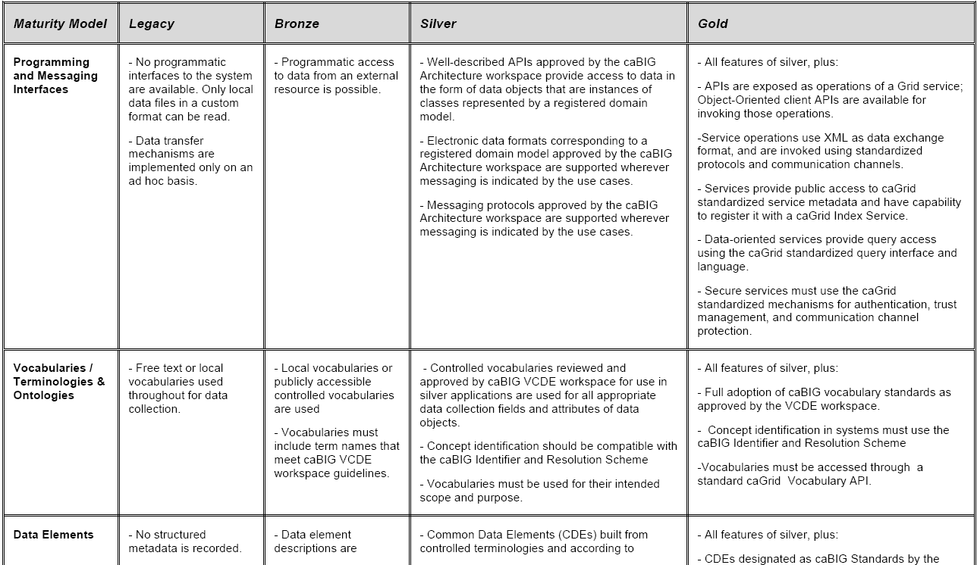

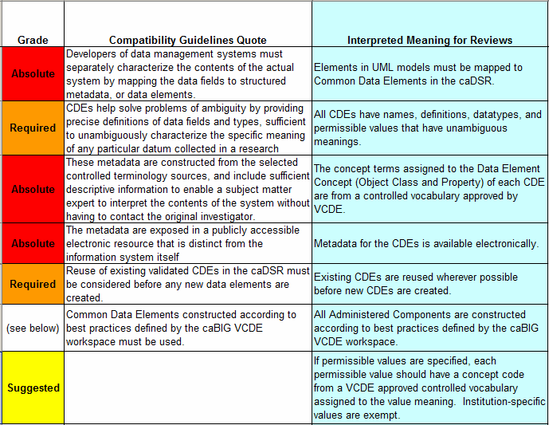
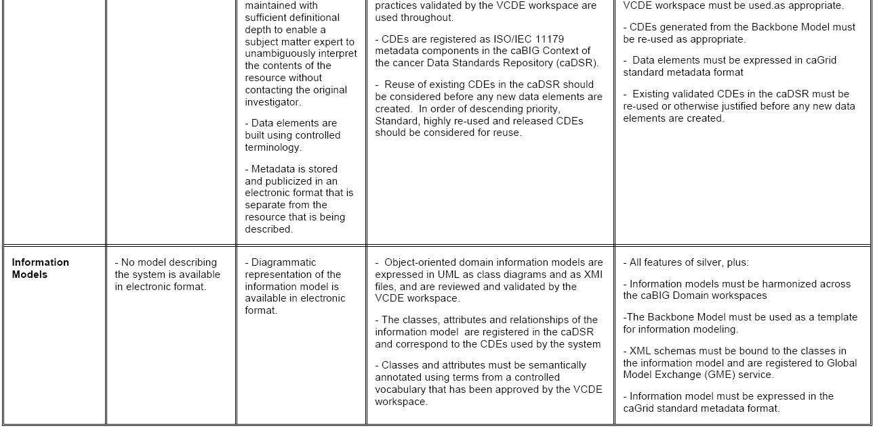
caBIG™ Compatibility Guidelines
Guidelines: The minimum requirements that must be met by a system before it is "caBIG™ Compatible".
The checklists are derived from the caBIG™ Compatibility Guidelines document
Notes:
We have guidelines. Guidelines sets the minimum requirements for certain level of compatibility.
There are different levels of compatibility Legacy, Bronze, Silver, Gold.
We have checklists derived from guidelines. Checklists are used by reviewers. However they are public documents that can help during development.

Slide 39
Areas of Compatibility
Information Models
  Human- and machine-readable object-oriented model of the system
  Details associations and relationships between objects
Common Data Elements
  Metadata descriptions that define and describe data
  Tagged with concepts from accepted vocabularies
  Used to join data from different models
Vocabularies and Ontologies
  Collections of agreed-upon concepts, terms, and definitions
  Used to define metadata (e.g. CDEs) and data (e.g. Permissible Values)
Programming and Messaging Interfaces
  Systems that allow access to resources
  Based on the information model
  Uses agreed-upon standard syntaxes or formats
Notes:
What are the areas of compatibility?
There are four: Information Models, Common Data Elements, Vocabularies and Ontologies, APIs
Information models. Common Data Elements and Vocabularies are mostly to facilitate semantic interoperability.
Programming and Messaging Interfaces are to facilitate syntactic interoperability.

Slide 40
Silver Level Compatibility Main Points
Information Model
  Classes sufficiently distinct for appropriate semantic integration
  Semantic annotation conforms to described data
  UML modeling best practices were followed
Common Data Elements
  All attributes correctly annotated and loaded into caDSR
  Semantic annotation is complete and accurate
  Value domains are curated, where appropriate
  Data Elements are reused, where appropriate
Notes:
IM
Classes representing real life things as possible. Distinct enough not to cause semantic ambiguity.
Synonymity between annotation and descibed data is important.
CDE
Data Element reuse; Standard or not; is particularly important to facilitate interoperability.

Slide 41
Silver Level Compatibility Main Points
Vocabularies and Ontologies
  Standard vocabularies/terminologies are used, where appropriate
  All terminologies must be publicly available
  Concepts used to annotate classes and attributes must be from Enterprise Vocabulary Services (EVS)
Programming and Messaging Interfaces
  API exists, well-described and documented
  API provides access in the form of data objects that are instances of classes represented by information model
Notes:
Client APIs are object-oriented and are specific to a particular programming language
Messaging APIs use a standard messaging protocol, are not object-oriented, and are not bound to a specific programming language

Slide 42
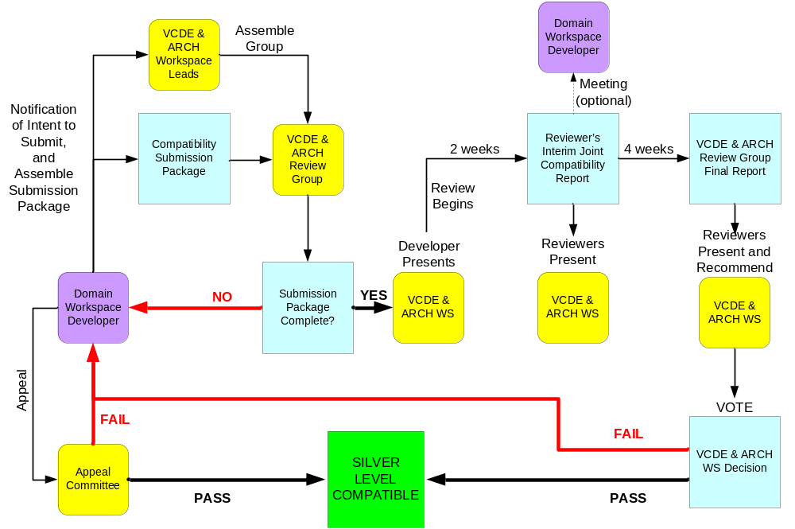
Silver Level Review Process Overview
Notes:
A developer prepares a compatibility submission package and x-cutting workspace leads assembles a review group.
Review group, if submission package complete, does an interim review and as necessary presents to x-cutting WS’s and as needed to developers.
Finally when review finishes, the results are presented to x-cutting WSs for a vote.
There is also an appeal process.

Slide 43
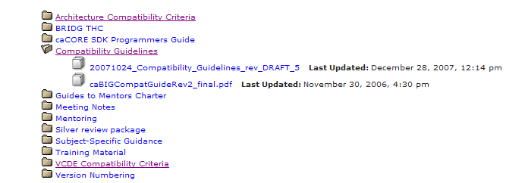
Additional Information
Guide to Mentors Docs:
https://gforge.nci.nih.gov/docman/?group_id=233

Slide 44
Why do we ask all this for caBIG™ Silver Level Compatibility?
Let’s fast forward and see services in action:
What one can do with caGrid services and silver level compatible data services?
How interoperability can be achieved?

Slide 45
Using caGrid for Semantic Interoperability

Slide 46
Outline
Background
A Scientific User Scenario
caBIG™ Translation of the User Scenario
caGrid Services In Action
Conclusion

Slide 47
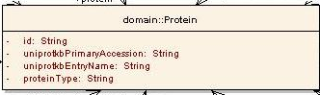
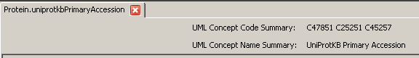
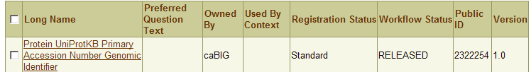
Background: Metadata Overview
UML Modeling
UML Class/attribute
EVS Concept Codes
Semantic Annotation using EVS concepts
CDE Public ID/version
CDE Long Name
caDSR Load/CDE Creation
Notes:
You will see in the afternoon and heard in Silver Level Compatibility
Every system needs information model in UML
All the attributes and classes for this system is annotated using terms/concepts from Enterprise Vocabulary Services specifically NCI-T
The information model is registered in cancer data standards repository and transformed to common data elements.
For now consider each class/attribute/data type tuple corresponds to a CDE. Each CDE has a public ID.

Slide 48
Background: caGrid Infrastructure
All the metadata is exposed via caGrid core service APIs:
  EVS: Vocabularies/concepts
  caDSR: Model Components/Common Data Elements
  Index Service: Service metadata including annotated domain model to discover services
Notes:
EVS – What vocabularies are available? What is the concept code for a “term”? What synonyms for this term?
caDSR – What are the classes/attributes/associations registered for service X? What are the CDEs for service X?
Index Service – What is the model exposed? Where the service is located? What is the end-point for the service? It is the yellow pages for caGrid

Slide 49
A Scientific User Scenario
A researcher is studying human BRCA1 gene and wants to find information available in public resources on protein encoded by this gene

Slide 50
A Scientific User Scenario – Details
A researcher is studying human BRCA1 gene and wants to find information available in public resources on protein encoded by this gene.
Reading carefully:
Multiple “resources”
“Gene” and “Protein” concepts
A specific “human” gene with name “BRCA1”
Notes:
How can one find multiple resources?
How can one find info on things like “Gene”/”Protein”?
How can one query resources with restrictive criteria?

Slide 51
caBIG™ Translation of the User Scenario
Discover multiple caGrid Data Services providing Protein information
  Use caGrid Discovery Client
Find how to combine the information from these Data Services
  Find semantically equivalent data elements (Common Data Elements) from different data services
Identify/query the Protein corresponding to BRCA1 gene
  Run caBIG™ Query Language (CQL) queries using caGrid Data Service Client
Collect information on the same protein from different resources
  Run multiple or federated CQL queries against different Data Services leveraging Common Data Elements
Notes:
If we detail the steps to meet help this user:

Slide 52
Discover caGrid Data Services providing protein information
Some possible ways to use caGrid Discovery Client:
  Search by “search string” “Protein”
    Not specific enough: Service descriptions may mention “Protein”
  Search by EVS Concept Code for “Protein”
    Code usually more specific: Less likely to find service description that contain an EVS Concept Code “C99999”
Notes:
Let’s use EVS Client API to find the concept code for “Protein”

Slide 53
Find EVS concept code for Protein
EVSGridServiceClient client=new EVSGridServiceClient(serviceURL_EVS);
//set search parameters for EVS query
EVSDescLogicConceptSearchParams evsSearchParams = new EVSDescLogicConceptSearchParams();
//set vocabulary to be used
evsSearchParams.setVocabularyName("NCI_Thesaurus");
evsSearchParams.setSearchTerm(“Protein”);
evsSearchParams.setLimit(10);
DescLogicConcept[] descLogicConcepts = client.searchDescLogicConcept(evsSearchParams);
Notes:
Point here is we are programmatically accessing a remote service, which happen to be one of the caGrid core services.
We are using EVSGridServiceClient (you will see in Session 3). We search “Protein”.

Slide 54
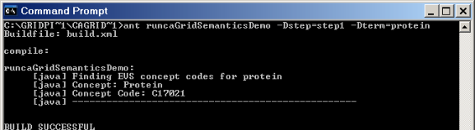
Find EVS concept code for Protein
ant runcaGridSemanticDemo -Dstep=step1 –Dterm=protein

Slide 55
Discover caGrid Data Services providing protein information
//instantiate a client
DiscoveryClient client = new DiscoveryClient(serviceURL_Index);
//search services end point exposing a model annotated concept code
EndpointReferenceType[] endPointReferenceArr=
client.discoverDataServicesByModelConceptCode(“C17021”);
Notes:
We are using DiscoveryClient to interact with Index Service and discover a service for a given criteria. It is a “Concept Code” in this case. The code we user here is for Protein and computed in previous step.

Slide 56
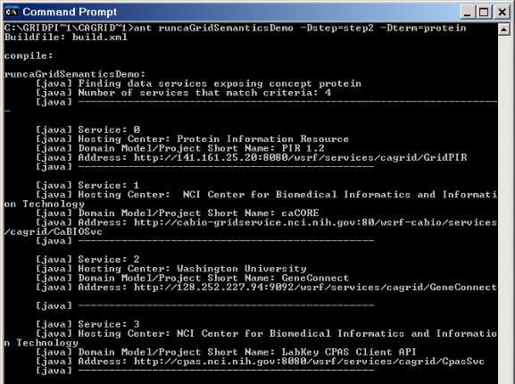
Discover caGrid Data Services providing protein information
ant runcaGridSemanticDemo -Dstep=step2 –Dterm=protein
Pick two services for next step

Slide 57
Find how to combine the information from these Data Services
DataServiceClient client_caBIO=new DataServiceClient(serviceURL_caBIO);
DataServiceClient client_gridPIR=new DataServiceClient(serviceURL_gridPIR);
//Download domain models from Data Services
DomainModel domainModel_caBIO;
DomainModel domainModel_gridPIR;
domainModel_caBIO=MetadataUtils.getDomainModel(client_caBIO.getEndpointReference());
domainModel_gridPIR=MetadataUtils.getDomainModel(client_gridPIR.getEndpointReference());
}
Notes:
Retrieve the model exposed by services from Index Service.

Slide 58
Find how to combine the information from these Data Services
Find semantically equivalent attributes using Common Data Elements (CDEs)
//Parse all the Data Elements from first model (NOT SHOWN)
//Parse all the Data Elements from second domain model and return common CDEs
umlClassArr=exposedUMLClassCollection2.getUMLClass();
for (int i=0;i<umlClassArr.length;i++){
UMLClassUmlAttributeCollection attributeCollection = (UMLClassUmlAttributeCollection) umlClassArr[i].getUmlAttributeCollection();
UMLAttribute [] umlAttributeArr=attributeCollection.getUMLAttribute();
for (int j=0;j<umlAttributeArr.length;j++){
MyDataElement dataElement=
new MyDataElement(umlClassArr[i],umlAttributeArr[j]);
if(dataElementMap.containsKey(dataElement.getPublicIDVersion())){
MyDataElement sourceDataElement=
(MyDataElement)dataElementMap.get(dataElement.getPublicIDVersion());
MyDataElementMap myDataElementMap=new MyDataElementMap(sourceDataElement,dataElement);
commonDataElementList.add(myDataElementMap);
}
}
}
Notes:
Not intended for reading. Just to prove it is programmatically possible to do so.
Get an intersection of two models and find semantically equivalent attributes using Common Data Elements (CDEs).

Slide 59
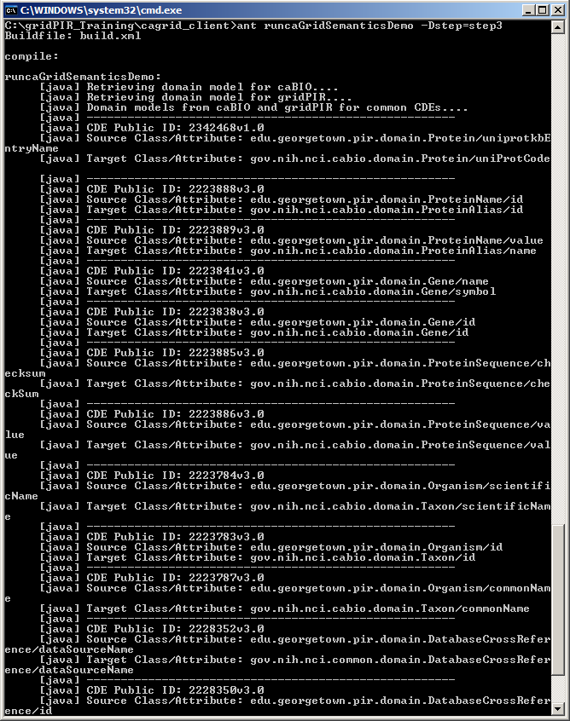
Find how to combine the information from these Data Services
ant runcaGridSemanticDemo -Dstep=step3
gridPIR’s Gene.name and caBIO’s Gene.symbol are semantically equivalent
Notes:
More on next slide….

Slide 60
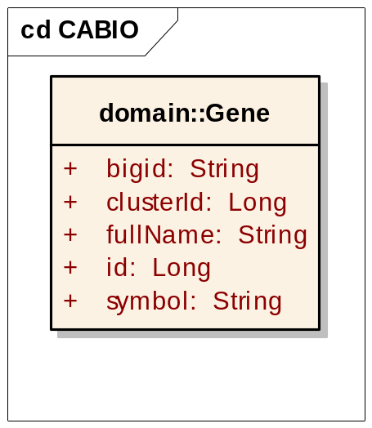
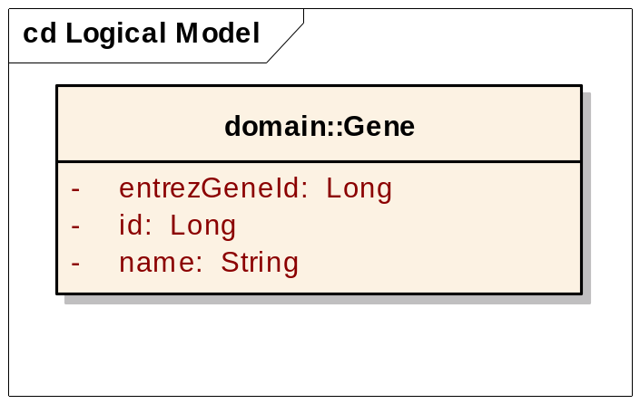
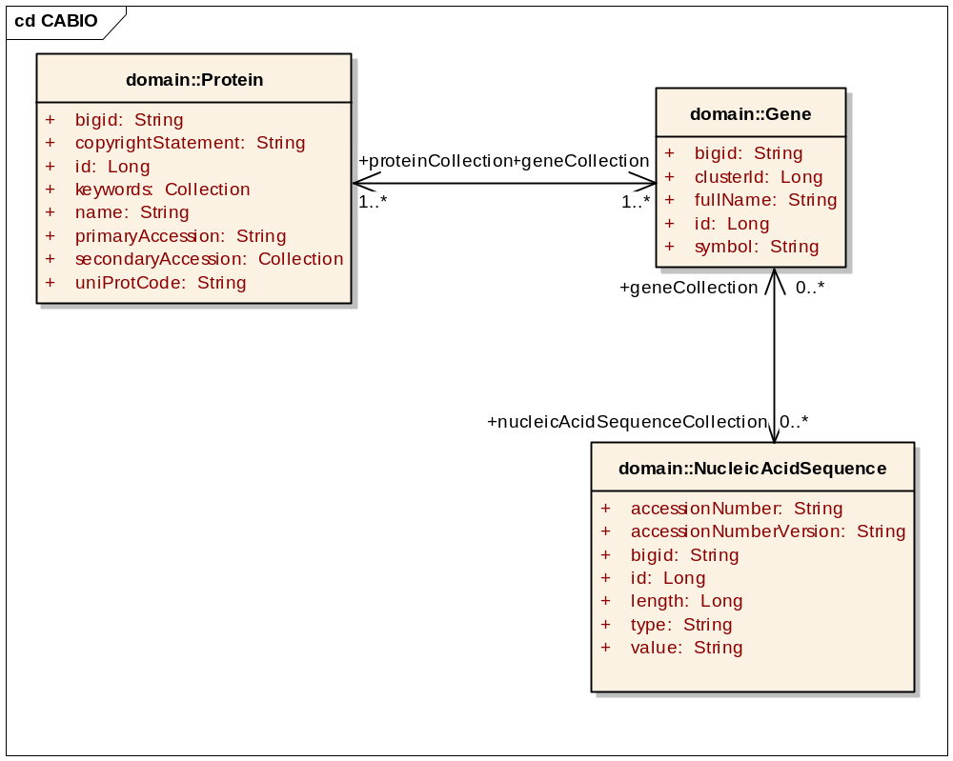
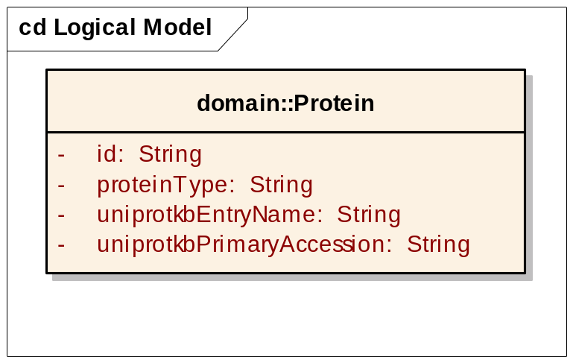
Find how to combine the information from these Data Services
Find semantically equivalent attributes using Common Data Elements (CDEs)
CDE: 2223841v3.0
gridPIR
caBIO
CDE: 2342468v1.0
Notes:
Here is another representation of semantically equivalent Class/attribute pairs.

Slide 61
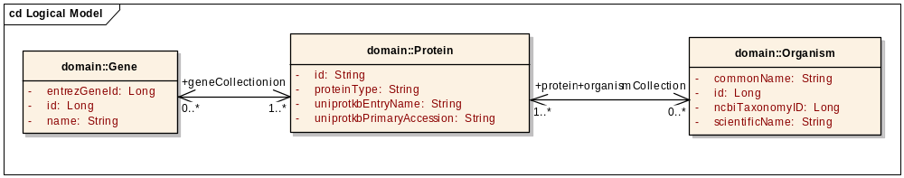
Identify/query the protein corresponding to BRCA1 gene
<?xml version="1.0" encoding="UTF-8"?>
<ns1:CQLQuery xmlns:ns1="http://CQL.caBIG/1/gov.nih.nci.cagrid.CQLQuery">
<ns1:Target name="edu.georgetown.pir.domain.Protein">
<ns1:Group logicRelation="AND">
<ns1:Association name="edu.georgetown.pir.domain.Gene" roleName="geneCollection">
<ns1:Attribute name="name" predicate="EQUAL_TO" value="brca1"/>
</ns1:Association>
<ns1:Association name="edu.georgetown.pir.domain.Organism" roleName="organismCollection">
<ns1:Attribute name="scientificName" predicate="EQUAL_TO" value="homo sapiens"/>
</ns1:Association>
</ns1:Group>
</ns1:Target>
</ns1:CQLQuery>
Notes:
We are using caBIG Query Language (you will see in Session 3). We are querying a Protein object that is from Organism “Homo Sapiens” and encoded by gene by name “BRCA1”

Slide 62
Identify/query the protein corresponding to BRCA1 gene
DataServiceClient client_gridPIR=new DataServiceClient(serviceURL_gridPIR);
CQLQuery query_gridPIR = (CQLQuery) Utils.deserializeObject(
new StringReader(
"<ns1:CQLQuery xmlns:ns1=\"http://CQL.caBIG/1/gov.nih.nci.cagrid.CQLQuery\">"+
"<ns1:Target name=\"edu.georgetown.pir.domain.Protein\">"+
…….
"</ns1:Target>"+
"</ns1:CQLQuery>"
),
CQLQuery.class
);
CQLQueryResults results_gridPIR=client_gridPIR.query(query_gridPIR);
Notes:
We are using DataServiceClient (you will see in Session 3). Submitting the query again programmatically.

Slide 63
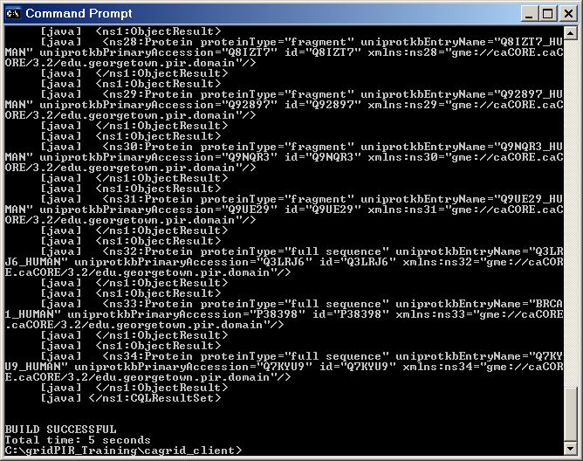
Identify/query the protein corresponding to BRCA1 gene
ant runcaGridSemanticDemo -Dstep=step4
Protein Object with uniprotkbEntryName BRCA1_HUMAN

Slide 64
Collect information on the same protein from different resources
We know
  “Protein.uniprotCode” in caBIO is semantically equivalent to “Protein.uniprotkbEntryName” in gridPIR :
  “BRCA1_HUMAN” protein from gridPIR corresponds to Human BRCA1 Gene
gridPIR
caBIO
CDE: 2342468v1.0
Notes:
What we know so far?

Slide 65
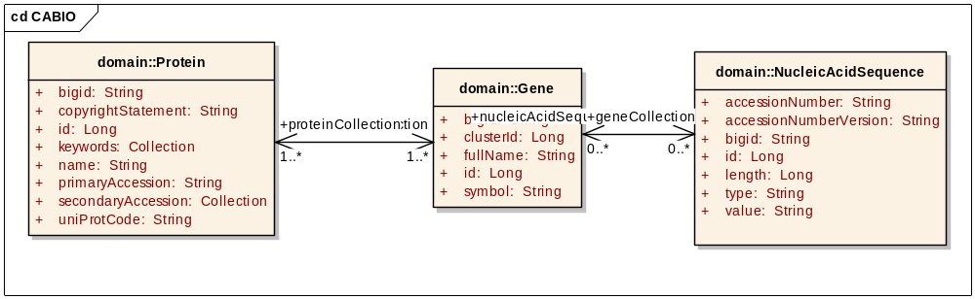
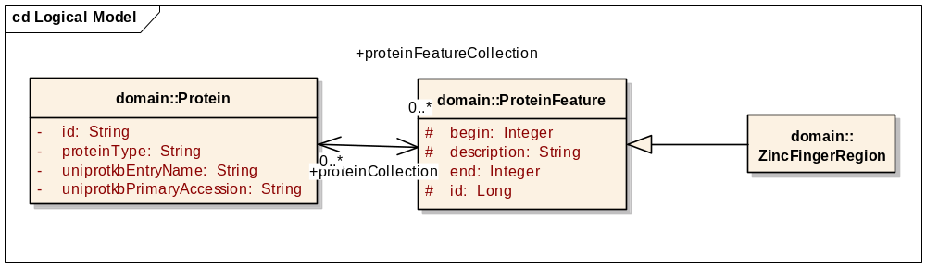
Collect information on the same protein from different resources
caBIO
Genomic Info
Join caBIO and gridPIRand access to more info
gridPIR
Annotations
Notes:
Use two differently named attributes to “join”/intersect two different models to gather more information.
Use the services as complementary to each other.

Slide 66
Collect information on the same protein from different resources
caBIO
<ns1:CQLQuery xmlns:ns1="http://CQL.caBIG/1/gov.nih.nci.cagrid.CQLQuery">
<ns1:Target name="gov.nih.nci.cabio.domain.NucleicAcidSequence">
<ns1:Association name="gov.nih.nci.cabio.domain.Gene" roleName="geneCollection">
<ns1:Association name="gov.nih.nci.cabio.domain.Protein" roleName="proteinCollection">
<ns1:Attribute name="uniProtCode" predicate="EQUAL_TO" value="brca1_human"/>
</ns1:Association>
</ns1:Association>
</ns1:Target>
</ns1:CQLQuery>

Slide 67
Collect information on the same protein from different resources
gridPIR
<ns1:CQLQuery xmlns:ns1="http://CQL.caBIG/1/gov.nih.nci.cagrid.CQLQuery">
<ns1:Target name=“edu.georgetown.pir.domain.ZincFingerRegion">
<ns1:Association name="edu.georgetown.pir.domain.Protein" roleName=“proteinCollection">
<ns1:Attribute name="uniprotkbEntryName" predicate="EQUAL_TO" value="BRCA1_HUMAN"/>
</ns1:Association>
</ns1:Target>
</ns1:CQLQuery>

Slide 68
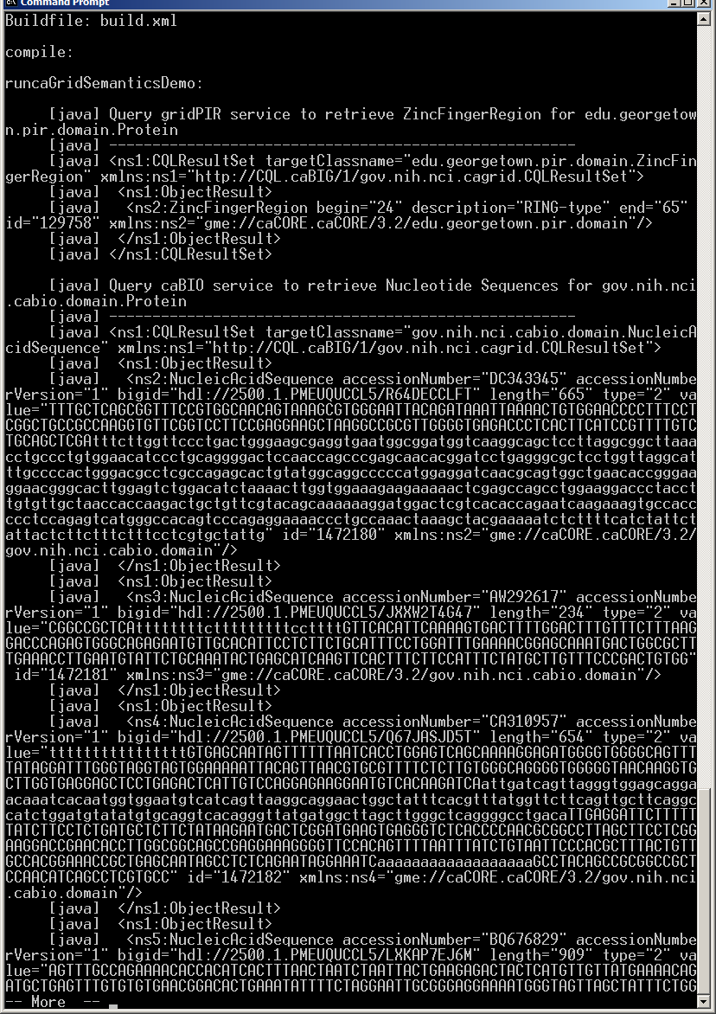
Collect information on the same protein from different resources
ant runcaGridSemanticDemo -Dstep=step5
Zinc Finger Region from gridPIR
Nucleic Acid Sequence from caBIO

Slide 69
Conclusion
Using caBIG™ silver level compatible caGrid Services supported by semantic metadata, one can:
  Discover information resources (Standard Vocabularies) – Semantic annotation is important
  Query resources using a standard language CQL (Standard APIs) – API/model correspondence is important
  Identify ways to combine information from multiple resources (CDEs) – CDE reuse is very important
Notes:
See how the guidelines and steps in demo are related.

Slide 70
Questions

Slide 71
See you after lunch for Session II and III.
Notes:
We will talk about how to generate such data services.

